Slide 1
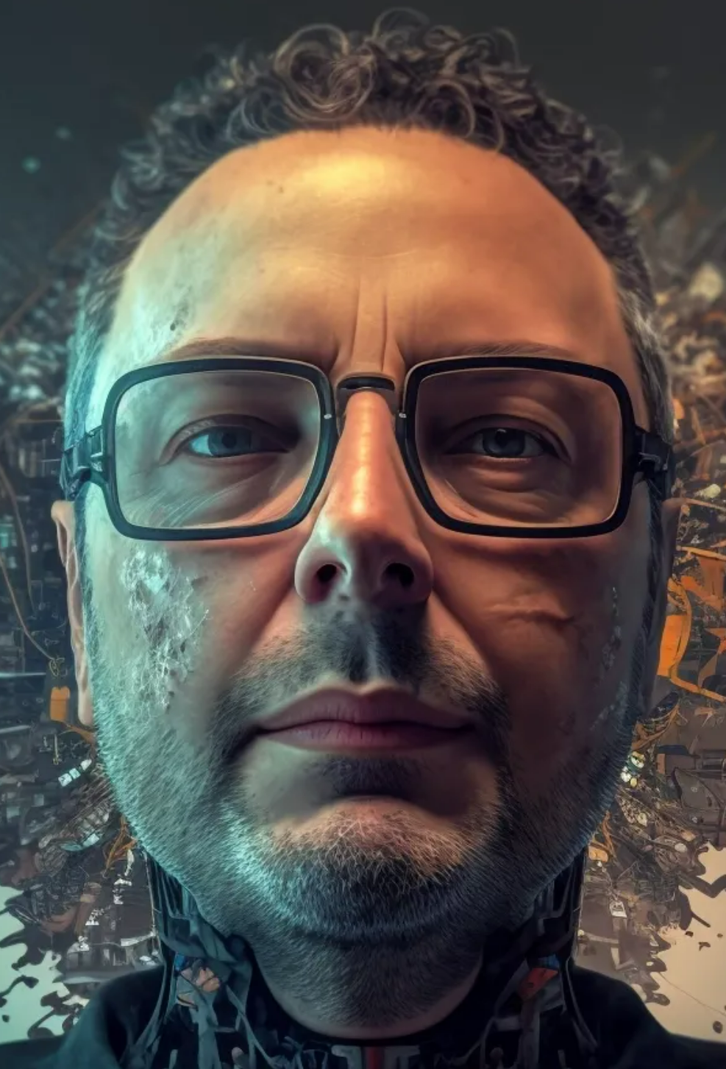

deep generative models
midjourney bot (2023)
Machine Learning Methods for Biomedical Data (D012554)

Slide 2
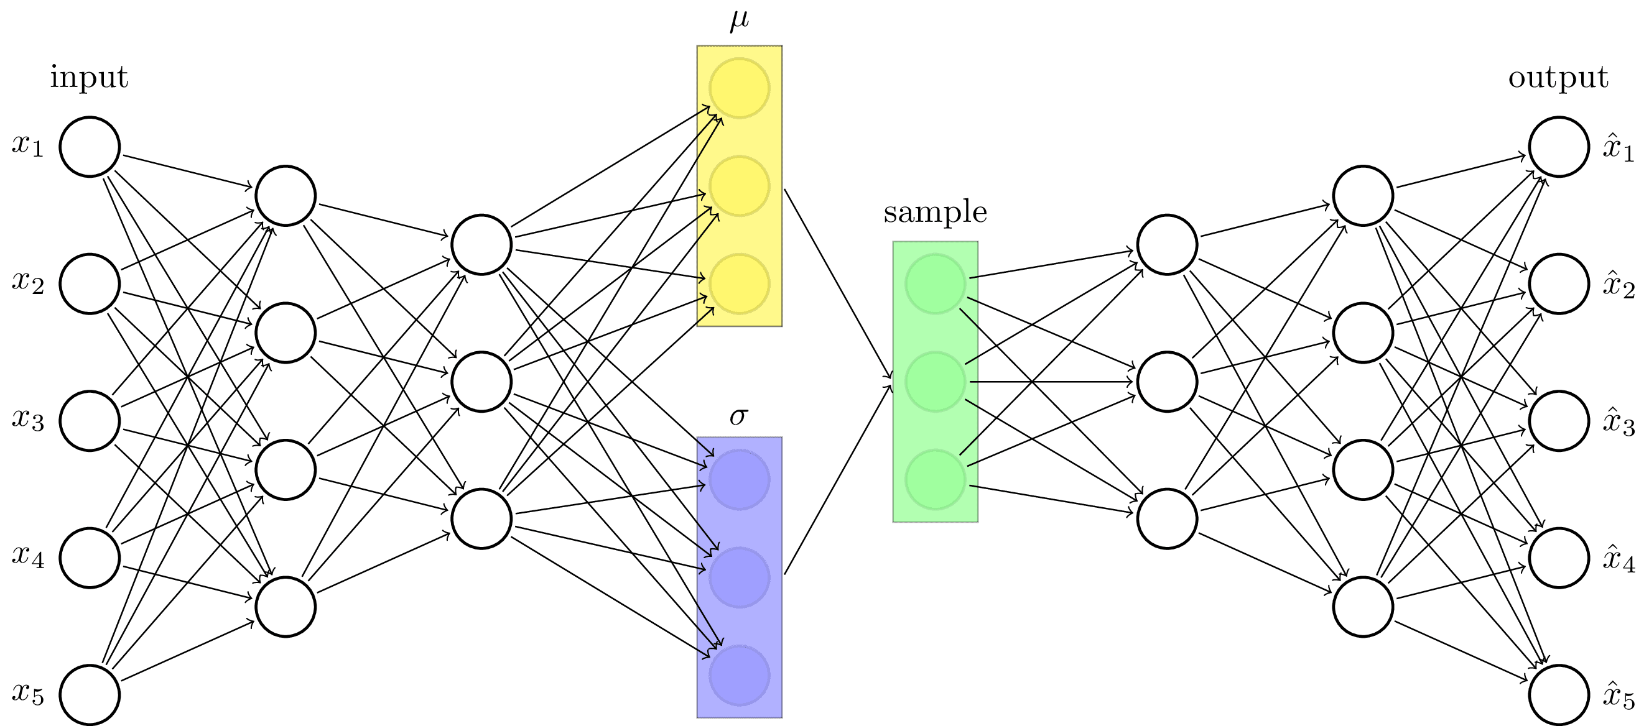
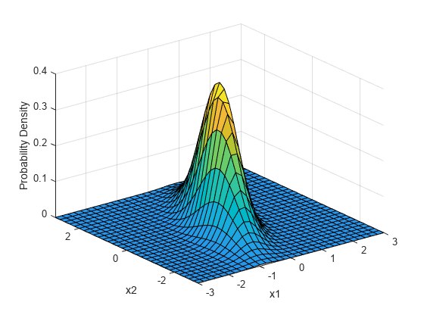
variational autoencoder
In an autoencoder the latent variable is not regularized, picking a random latent variable can generate garbage output.
A variational autoencoder solves this by mapping the input image to a distribution in the latent space, rather than a single point.

Slide 3
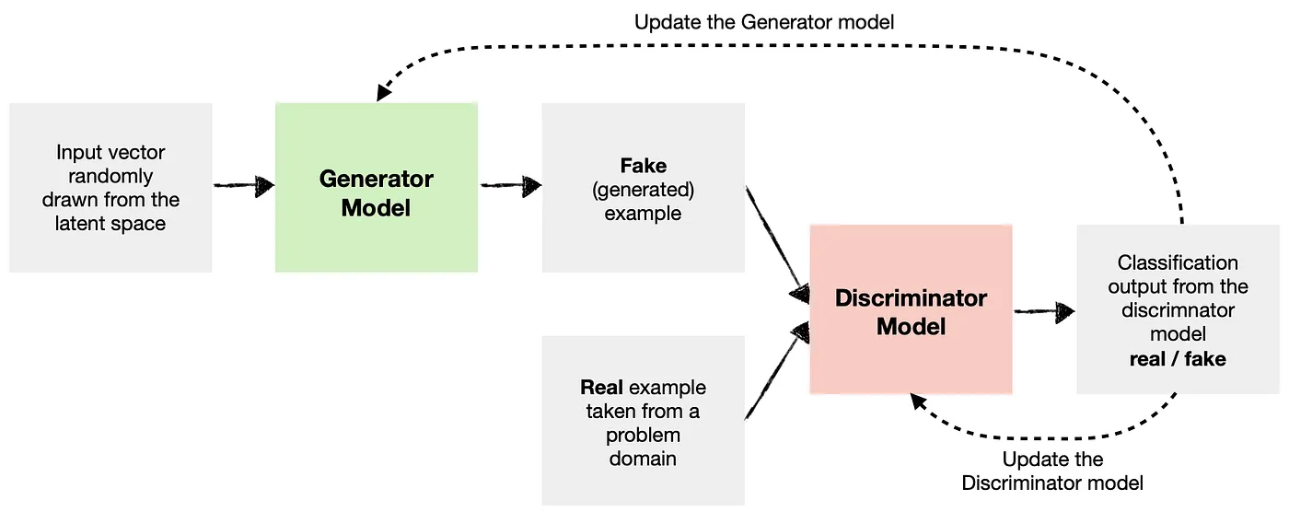
generative adversarial network (GAN)
The generator learns to generate new data (i.e., fake data) similar to that of the problem domain.
The discriminator learns to identify whether the provided example is fake (comes from a generator ) or real (comes from the actual data domain).
Both the generator and the discriminator are trained together.
.

Slide 4
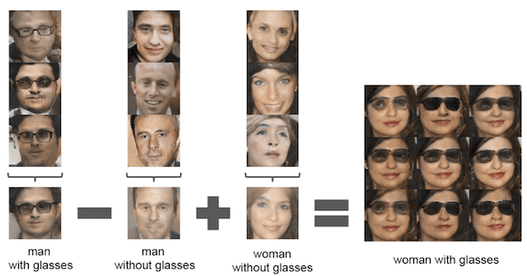
generative adversarial networks

Slide 5
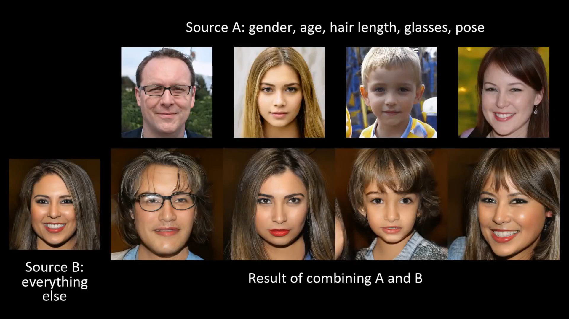
generative adversarial networks
Karras et al. IEEE Conference on Computer Vision and Pattern Recognition (2019)

Slide 6
generative adversarial networks
https://this-person-does-not-exist.com/
.

Slide 7
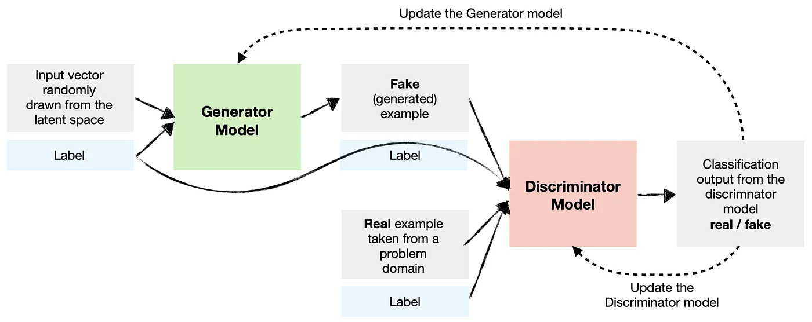
conditional GAN
A conditional GAN conditions both the generator and the discriminator so they know which type they are dealing with.

Slide 8
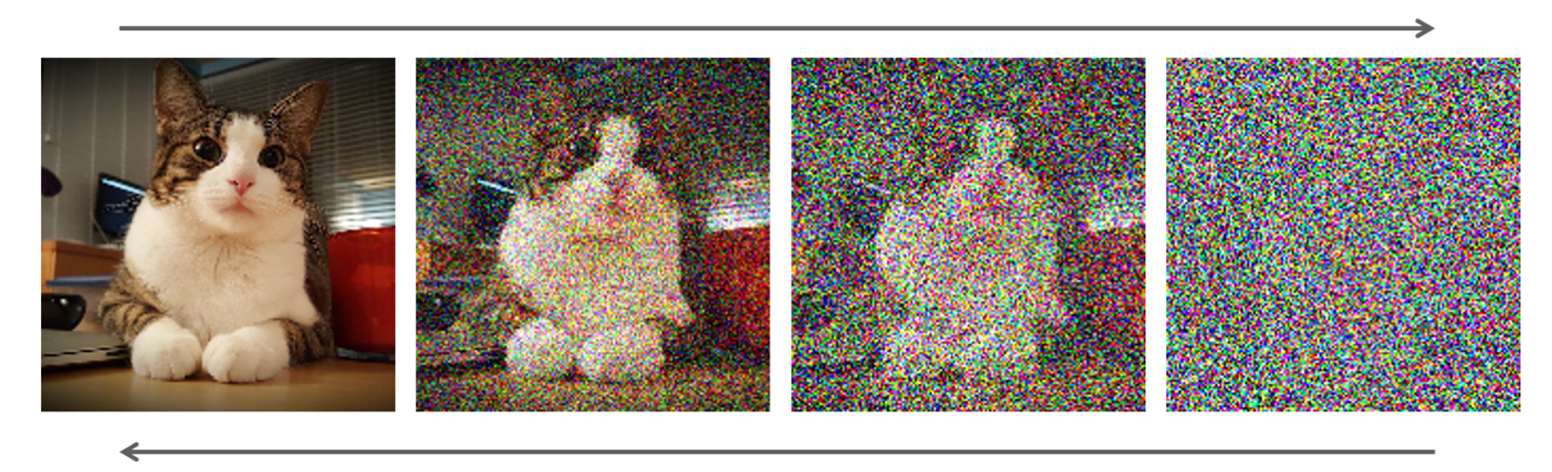
diffusion model
A diffusion model learns to denoise images blurred with Gaussian noise by learning to reverse the diffusion process.

Slide 9
diffusion model
A diffusion model learns to denoise images blurred with Gaussian noise by learning to reverse the diffusion process.

Slide 10
diffusion model
This de-noising process can be guided by an embedding of for instance a text prompt.
A popular approach is to use a Contrastive Language-Image Pretraining (CLIP) model to condition the de-noising.
The CLIP model is trained on image+caption data and learns to compute embeddings that are similar between the image and the caption.

Slide 11
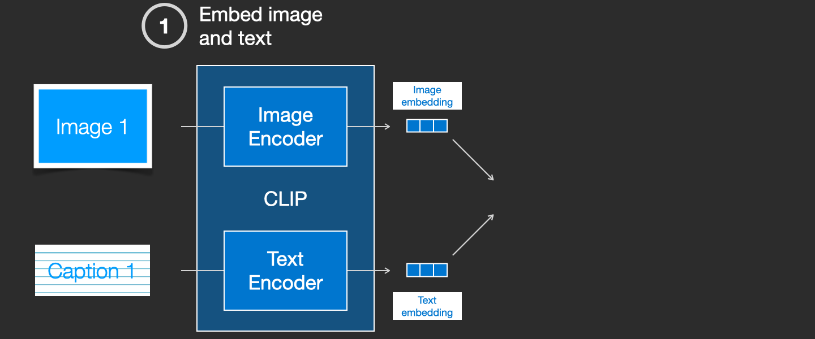
diffusion model
The CLIP model is trained on image+caption data and learns to compute embeddings that are similar between the image and the caption.
https://jalammar.github.io/illustrated-stable-diffusion/

Slide 12
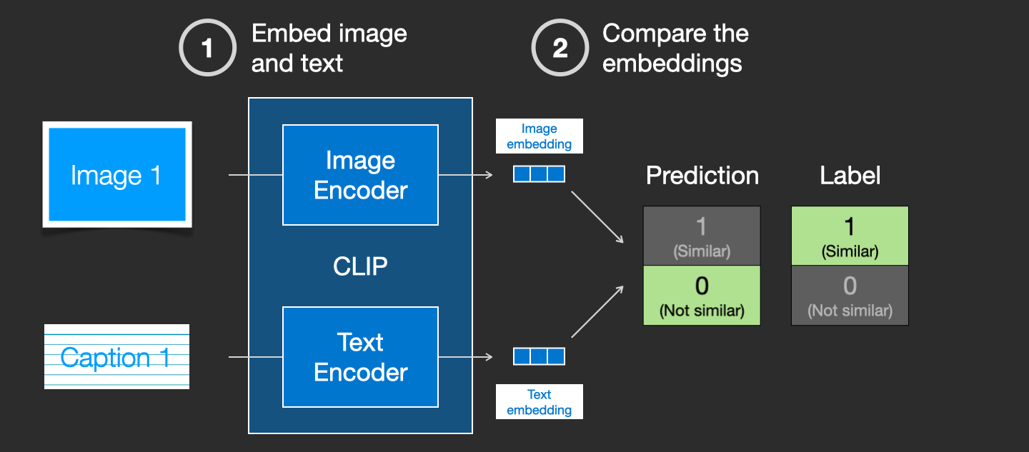
diffusion model
The CLIP model is trained on image+caption data and learns to compute embeddings that are similar between the image and the caption.
https://jalammar.github.io/illustrated-stable-diffusion/

Slide 13
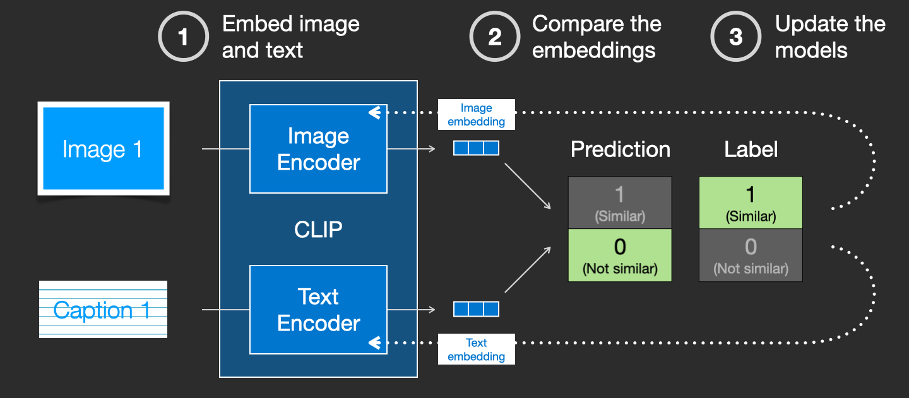
diffusion model
The CLIP model is trained on image+caption data and learns to compute embeddings that are similar between the image and the caption.
https://jalammar.github.io/illustrated-stable-diffusion/

Slide 14
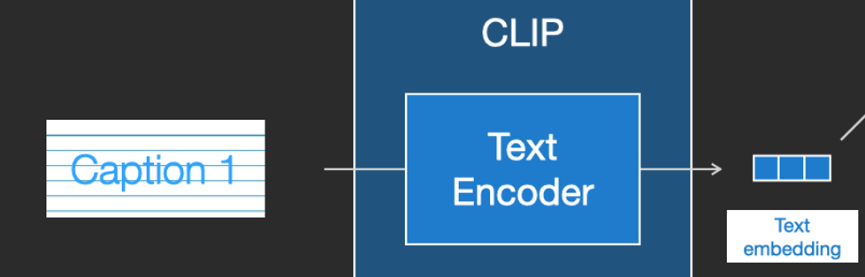
diffusion model
The idea is to guide the de-noising procedure such the image embedding that is being created from the noise goes into the direction of the text embedding computed by CLIP.
https://jalammar.github.io/illustrated-stable-diffusion/

Slide 15
diffusion model
RF Diffusion outperforms existing protein design methods across a broad range of problems, including topology-constrained protein monomer design, protein binder design, symmetric oligomer design, enzyme active site scaffolding, and symmetric motif scaffolding for therapeutic and metal-binding protein design.
https://www.bakerlab.org/2023/03/30/rf-diffusion-now-free-and-open-source/

Slide 16
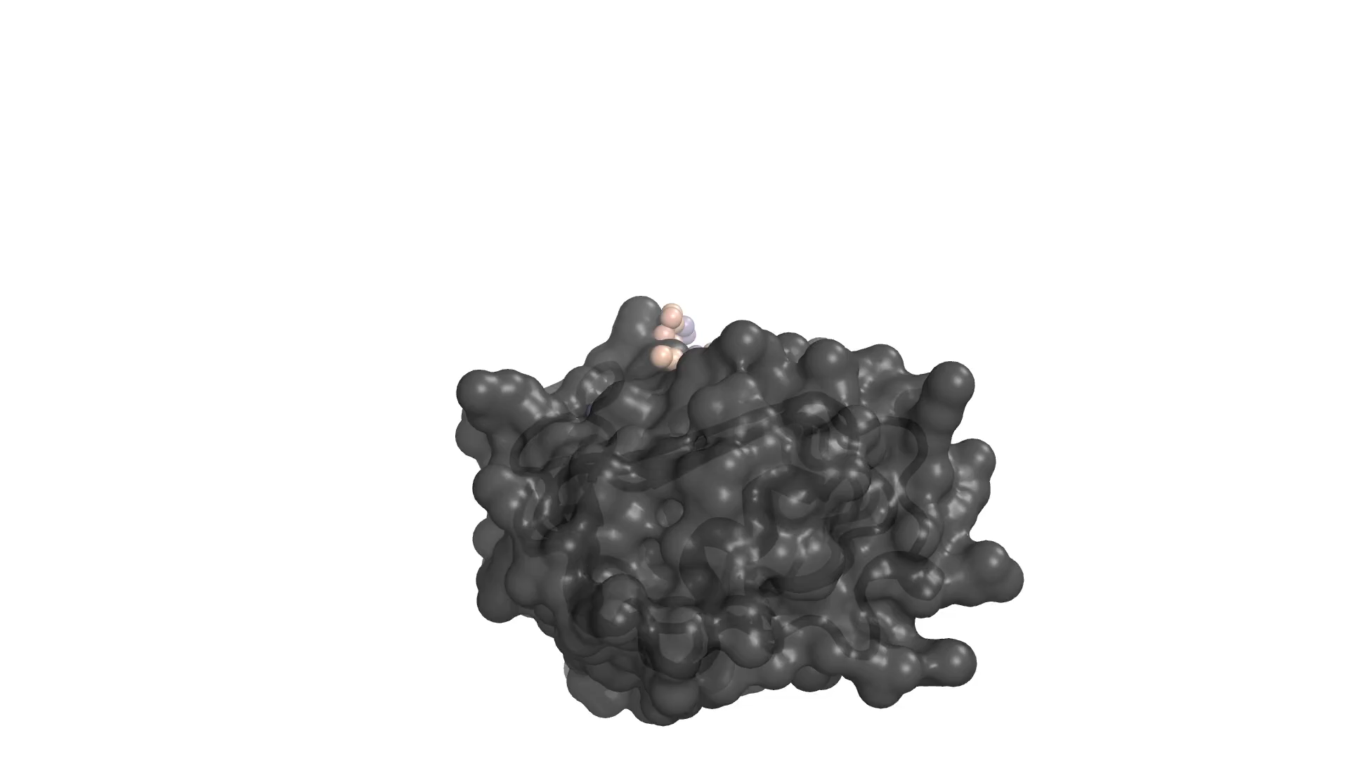
diffusion model
Here RF Diffusion generates a novel protein that binds to the insulin receptor.
https://www.bakerlab.org/2023/03/30/rf-diffusion-now-free-and-open-source/

